Slide 1
UK Accident Analysis
Mohini Patil
015359188

Slide 2
Background
Road safety is a major public health concern because there are many road crash fatalities and disabilities recognized every day.
Also, according to the World Health Organization (WHO), approximately 1.25 million people die in road accidents per year, on average 3,287 deaths per day.
Also, road traffic accidents rank 9th place as the leading cause of death. It also accounts for 2.2% of all deaths globally.
Using visualisation to solve this problem.
Objectives
To get insights from the collected accidents data
To identify the factors responsible for most of the accidents
To develop some prevention mechanisms for road safety

Slide 3
Dataset Description
Used the UK Road Traffic Accidents dataset from Kaggle
This data originally came from data.gov.uk website
Dataset contains 2 csv files
Accident_Information.csv
2 million rows, 34 columns
Contains information about accidents like accident severity, road conditions,
light conditions, weather conditions, police force, urban or rural area, date, etc.

Slide 4
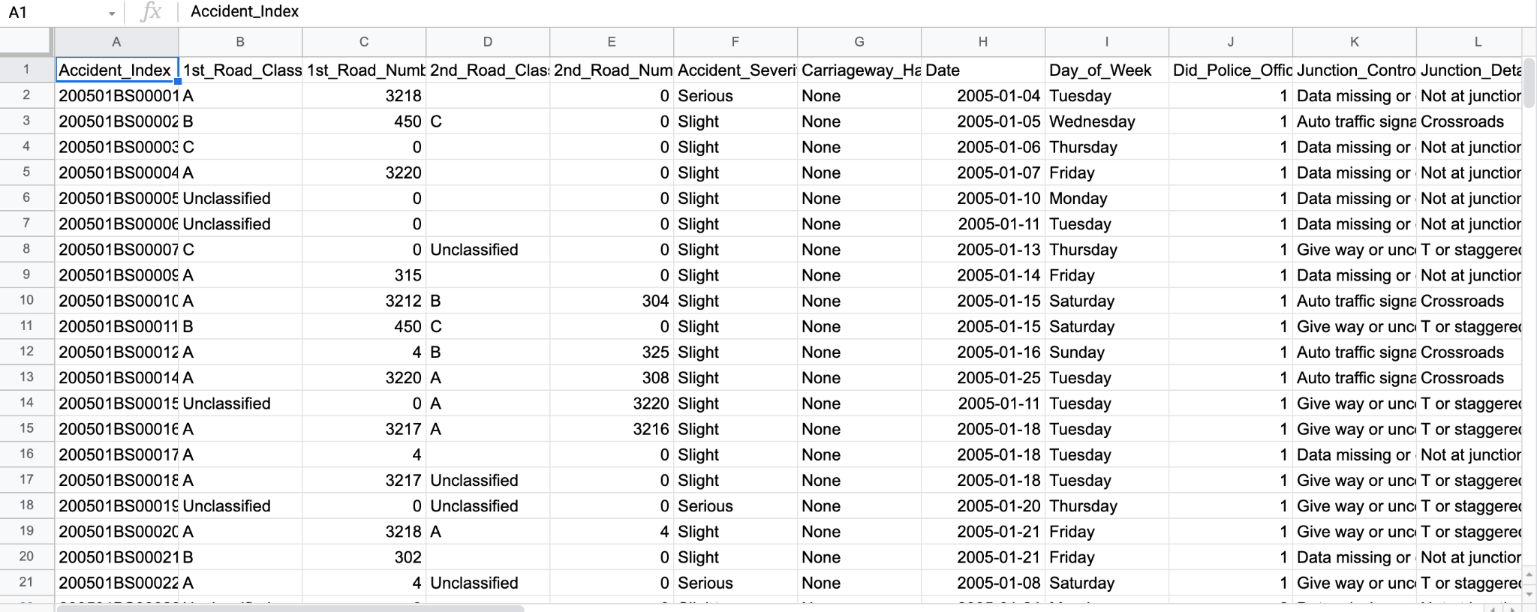

Slide 5
Dataset Description Cont..
Vehicle_Information.csv
2.1 million rows x 24 columns
Contains information about the vehicles present in the accident
Information like vehicle model, make, driver’s age, driver’s home area, etc.

Slide 6
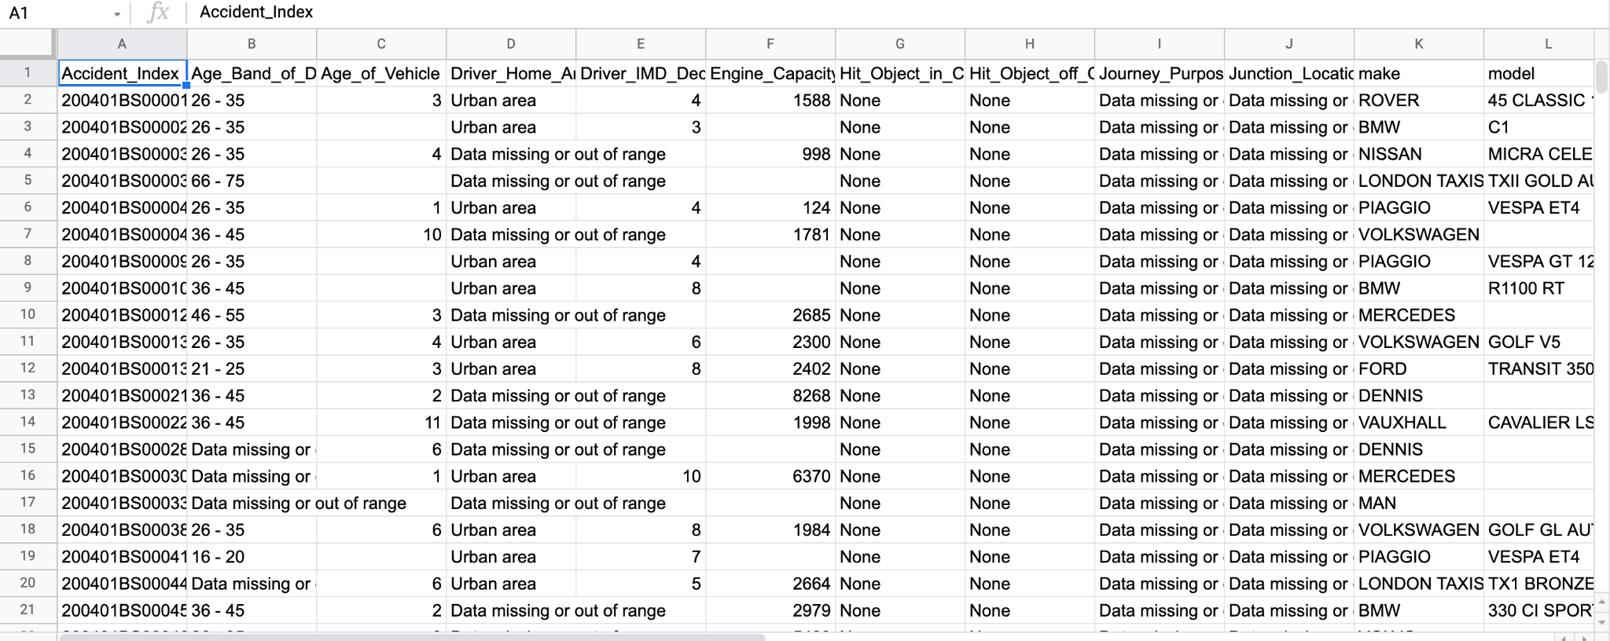

Slide 7
Data Cleaning
Raw dataset contains inaccurate, incorrect, incomplete, null records
Used Tableau Prep for cleaning the data
Removed null records
Removed unnecessary columns
Changed data type
Formatting of some values

Slide 8
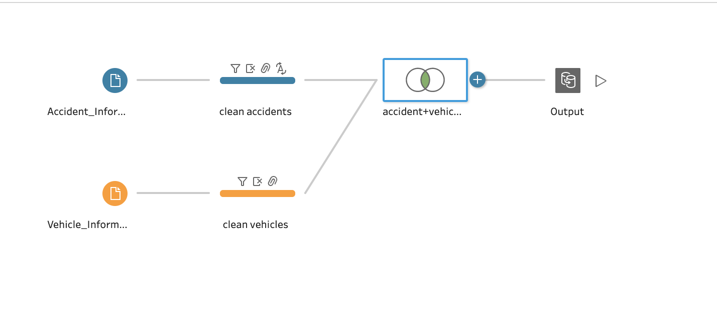
Flow Diagram

Slide 9
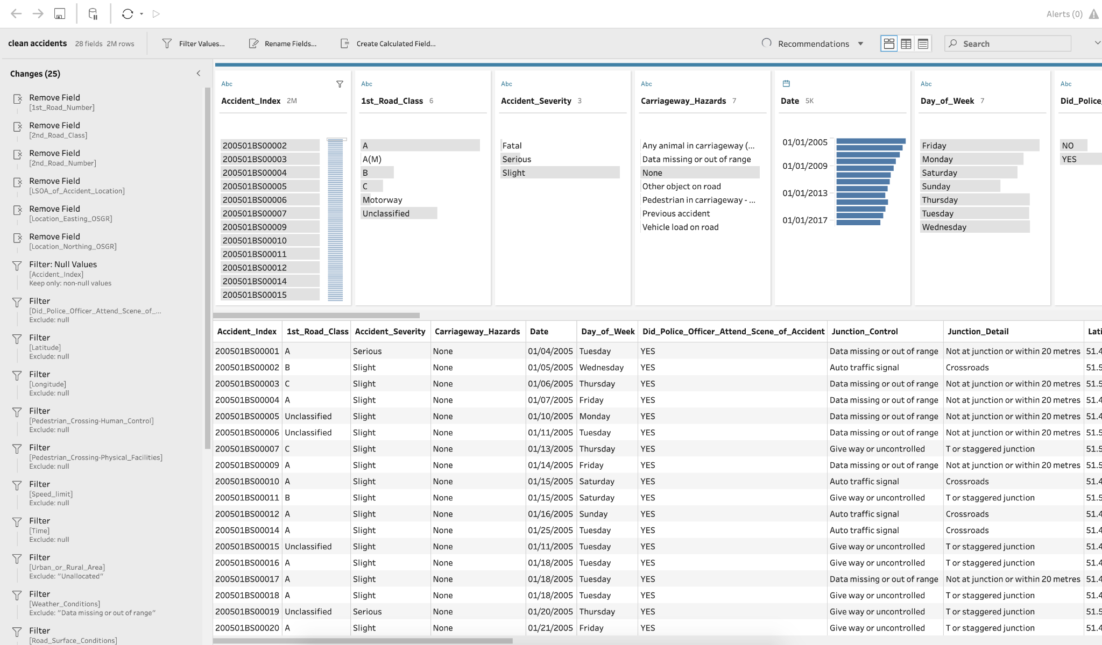
Cleaned Accident_Information

Slide 10
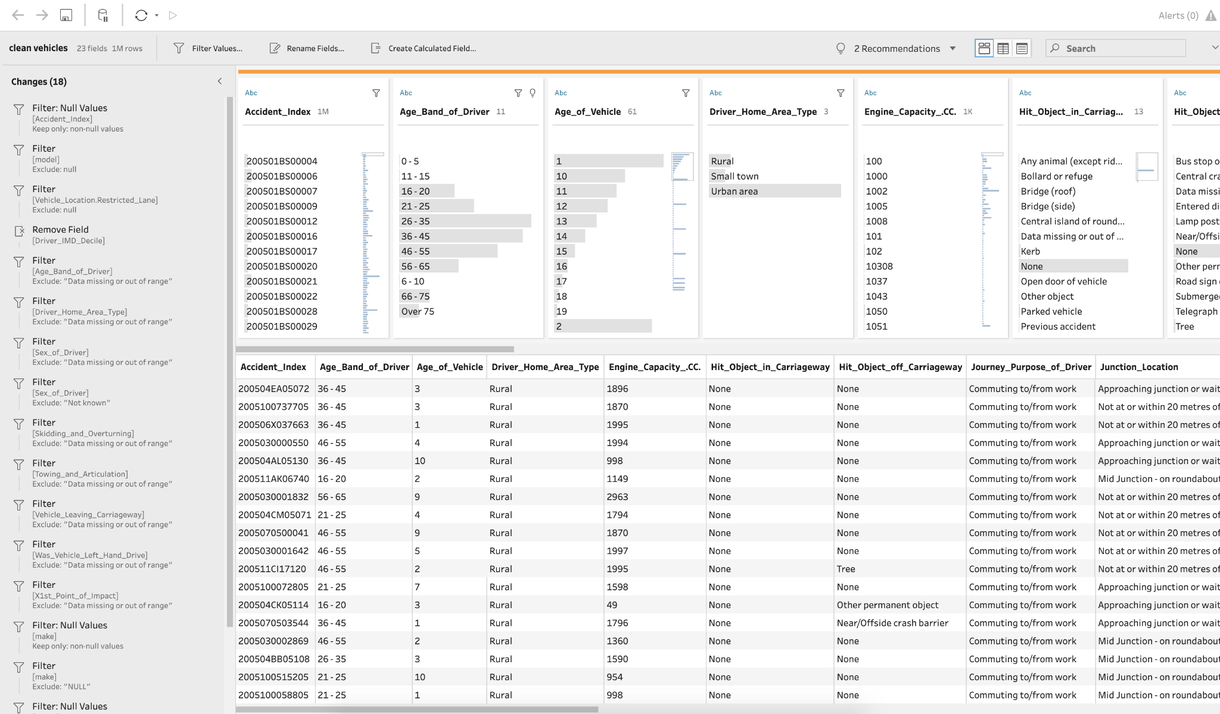
Cleaned Vehicle_Information

Slide 11
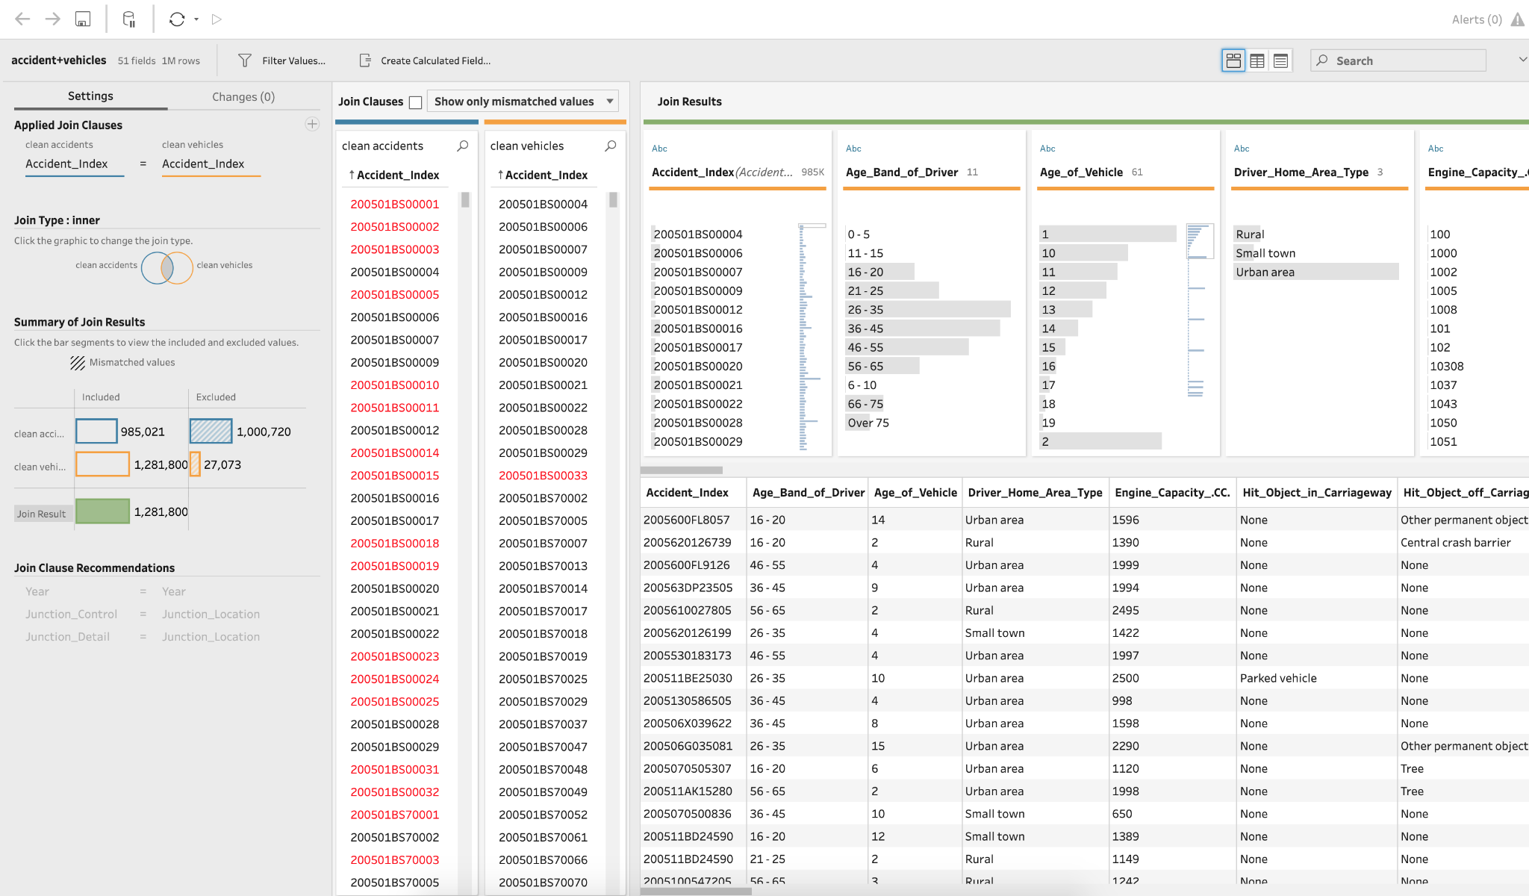
Accident+Vehicle

Slide 12
Objectives
The main objective of this project is to analyze the UK Road Safety data from the year 2005 - 2016 to answer the following questions:
What district in the UK has the highest number of accidents?
Did the police officer attend the accident site?
What are the effects of different light, weather, and road conditions on accident rates?
What vehicles are involved in accidents by make, model, and vehicle type?
What is the accident rate by age of the driver?
What are the number of accidents that happened by year, day of the week, and time of the day?
Domain Application: Traffic Accident Analysis
Domain Users: Highway Operators and Public Work Department Personnel

Slide 13
Exploratory Data Analysis
Used Tableau Desktop for data exploration
Created dashboards and story for analysis

Slide 14
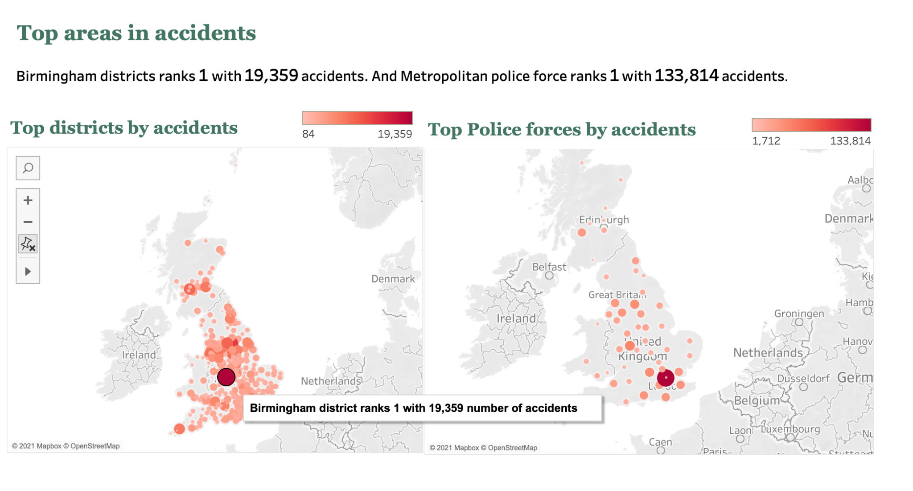
Top districts and police force areas of accidents

Slide 15
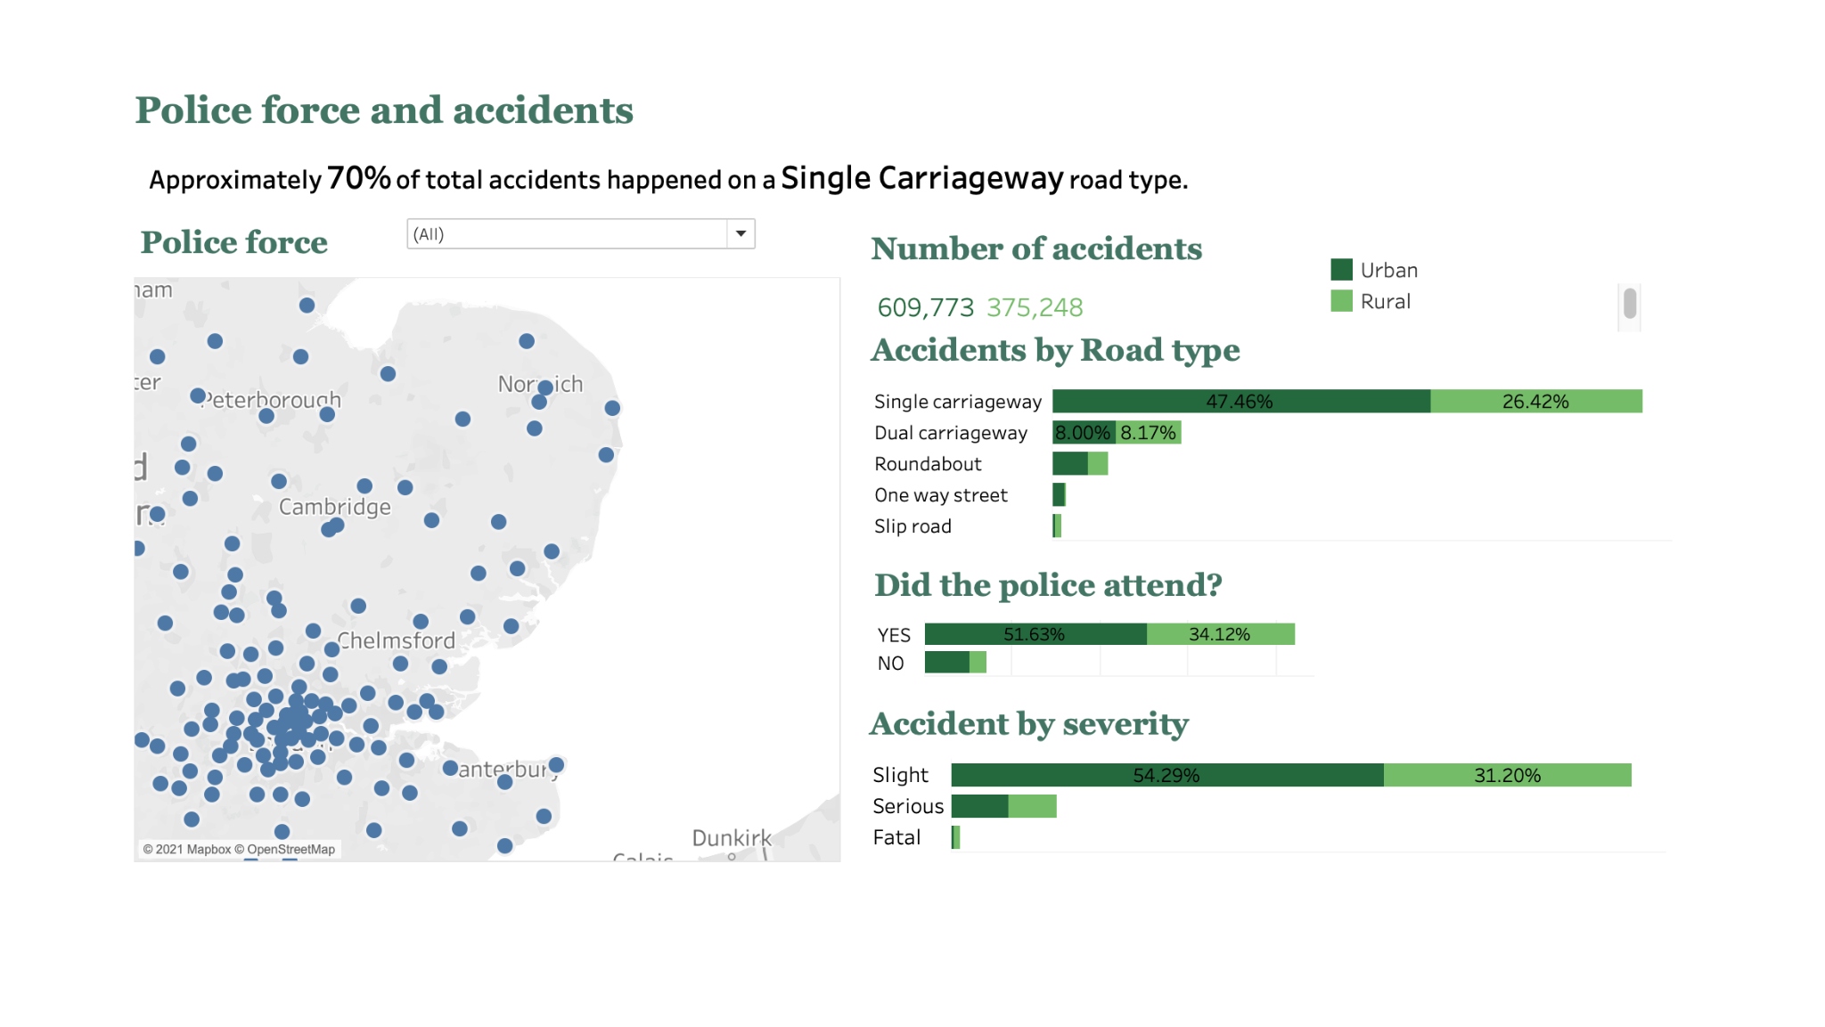
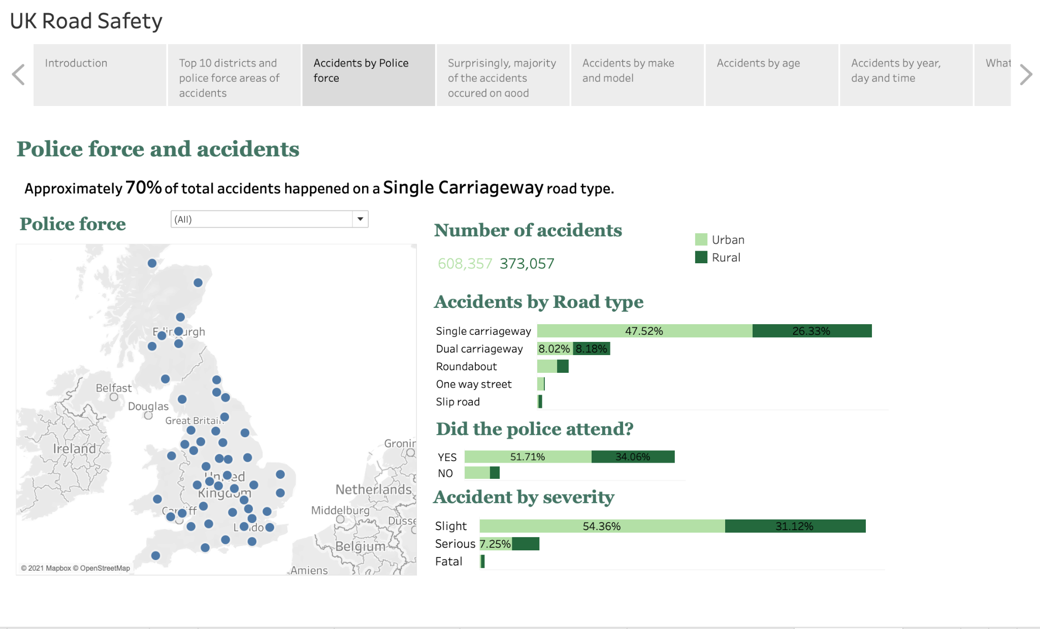
Accidents by police force

Slide 16
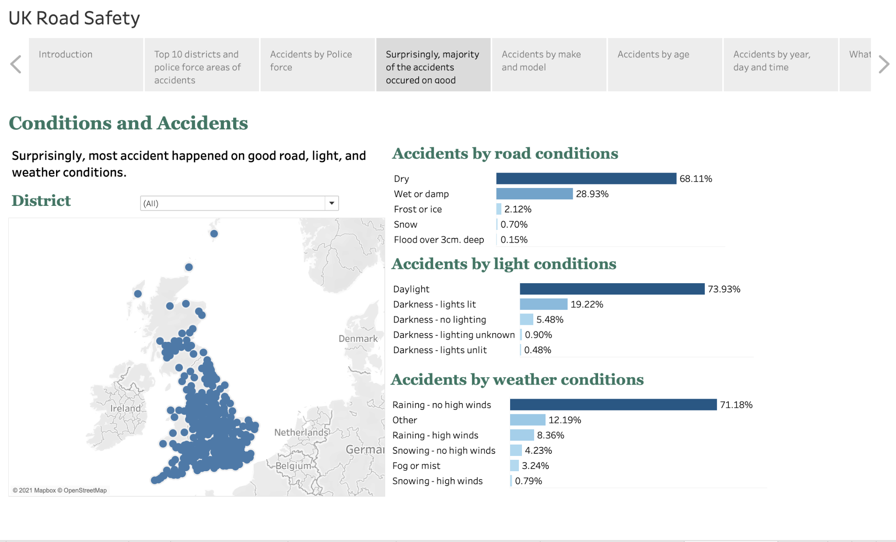
Accidents by conditions

Slide 17
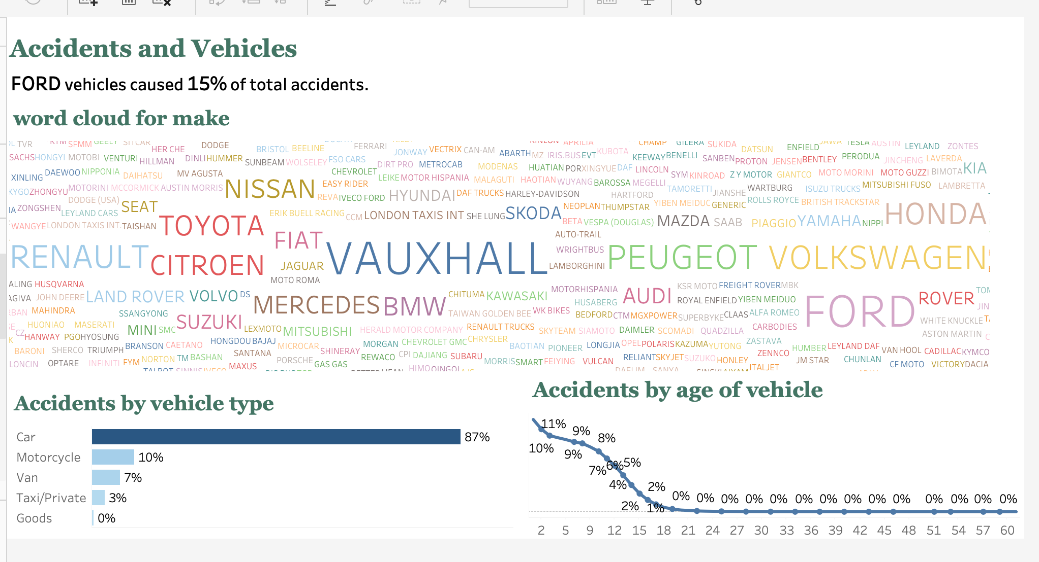
Accidents by make

Slide 18
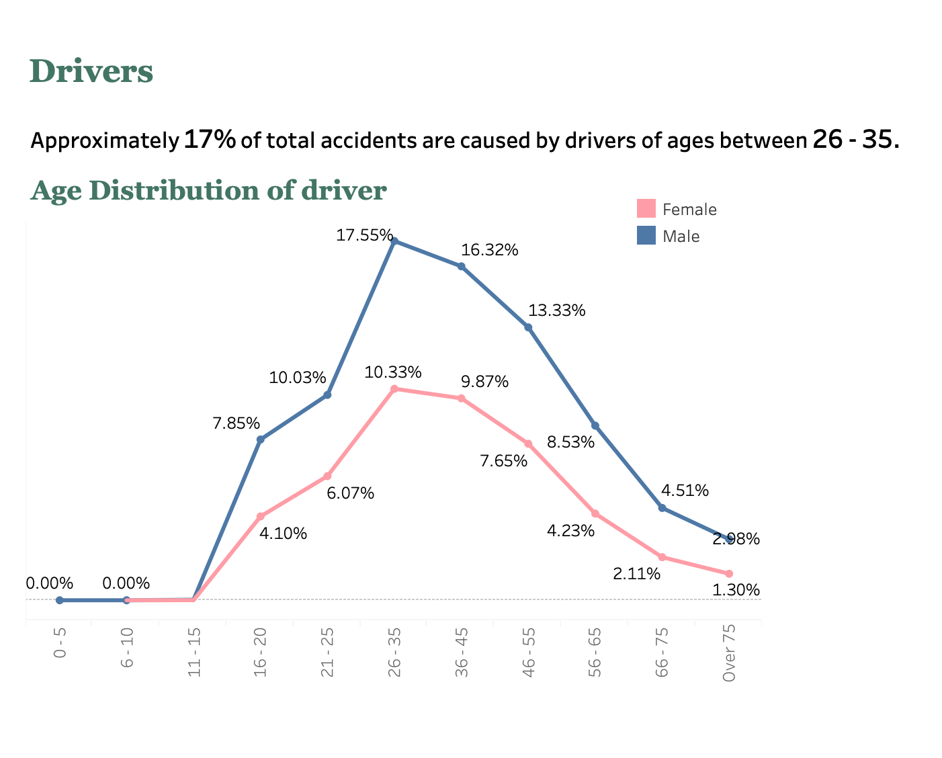
Accidents by age

Slide 19
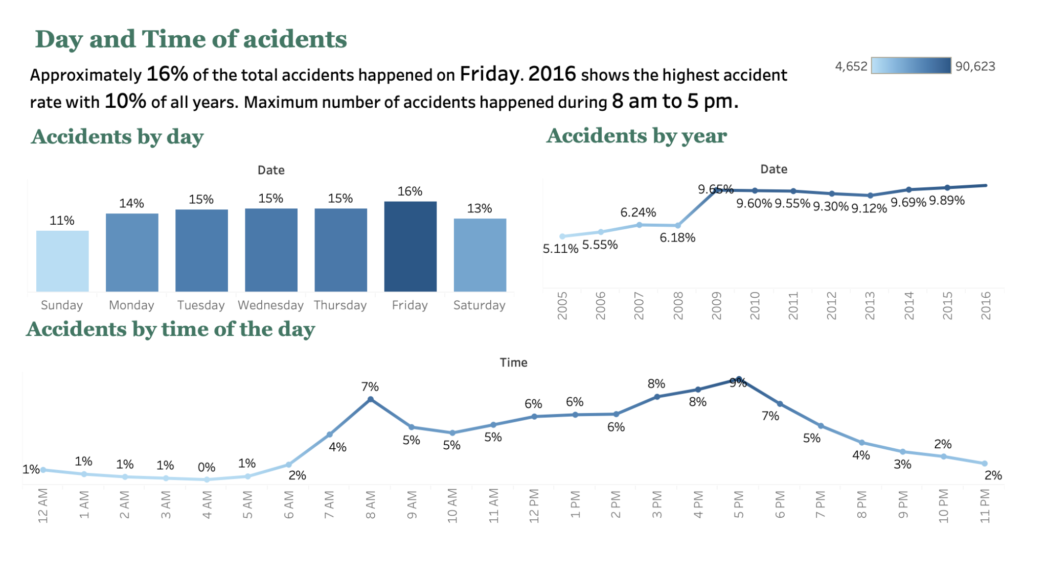
Accidents by year, day, and time

Slide 20
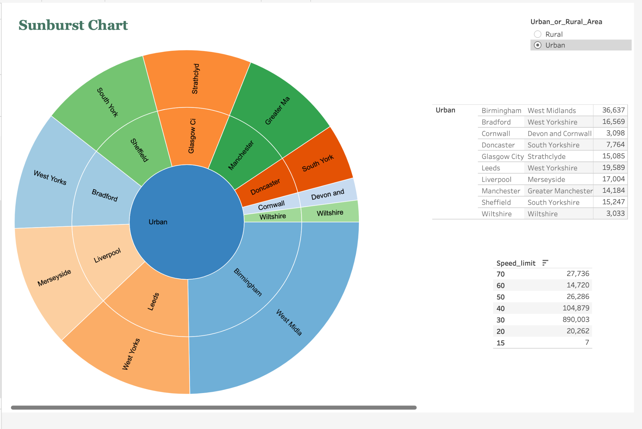
Graph Using Tableau Extension
Sunburst chart

Slide 21
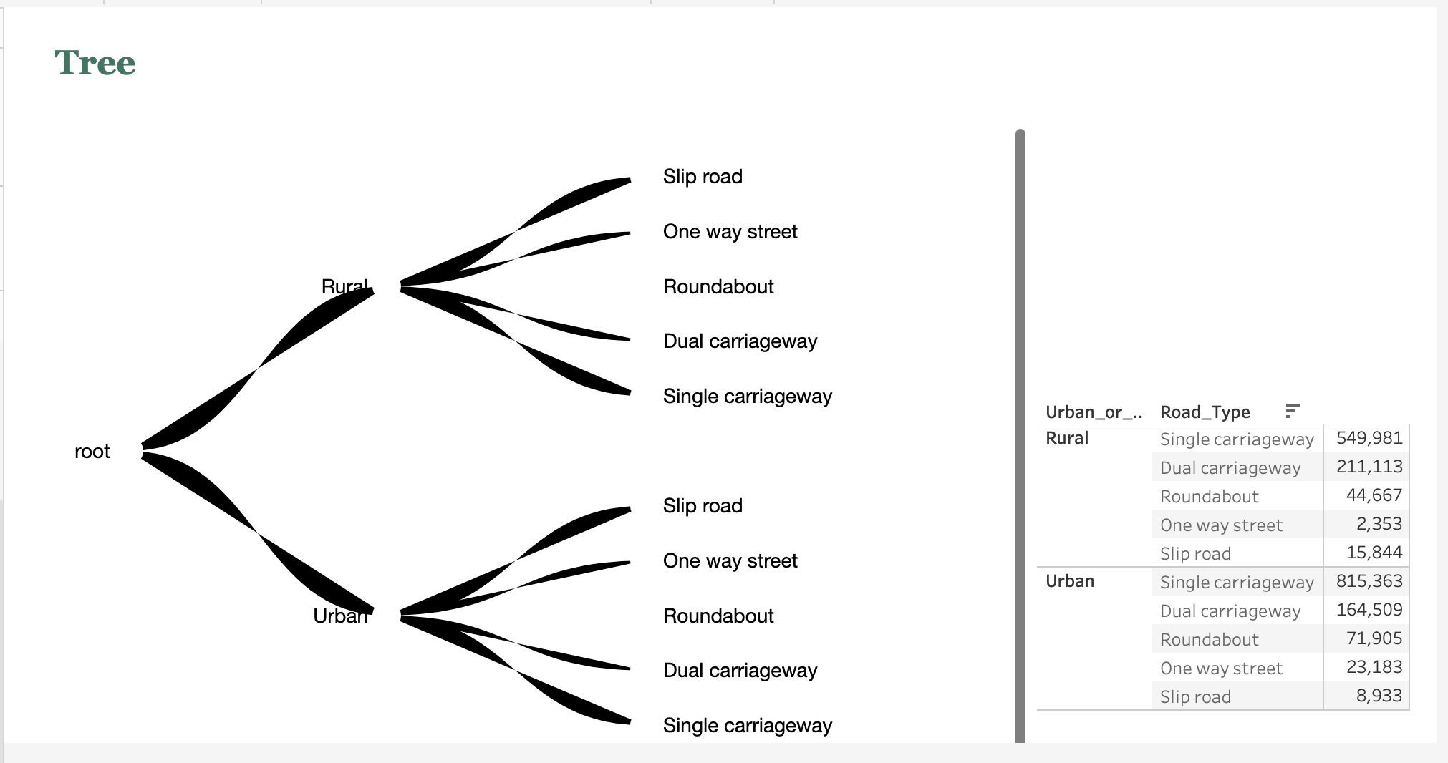
Tree

Slide 22
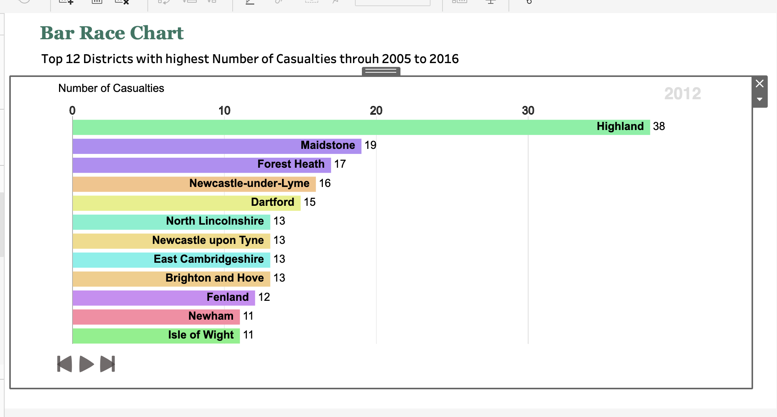
Bar Race Chart

Slide 23
What Can be done?
Birmingham being the highest prone area, more police force can be employed with strict rules. Speed limit should be enforced strictly.
Single carriageways can be modified to the possible extent.
Also, we saw that young people of age 26 to 35 years are involved in most of the accidents, so more awareness is needed to control and reduce the accidents.
Fridays found to be more accident prone days. One solution for this case is if possible to promote public transport on Fridays to control the rate of accidents.
Speed at the peak hours should also be controlled. More medical facilities can be provided till the conditions get better.
More light facilities can be provided to prevent accidents in the dark.
The design of the vehicles causing most accidents can be reviewed to prevent accidents.

Slide 24
Future Work
Using this analysis, we can build a predictive model to accurately determine the severity of accidents.
We can also try to build a recommendation system for the UK Department of Transport.
This system will help to improve road safety and also will help to reduce accidents.

Slide 25
References
https://www.kaggle.com/tsiaras/uk-road-safety-accidents-and-vehicles
https://www.gov.uk/government/collections/road-accidents-and-safety-statistics

Slide 26
Thank you

